Slide 1

Internet of Things (IoT)
for
B.Tech CSE 6th Sem
Thursday:: 23rd Jan:: 2025
Prof. Panchanan Nath :: Assistant Professor, Dept. of CSE :: NIST University :: Jan-July 25

Slide 2
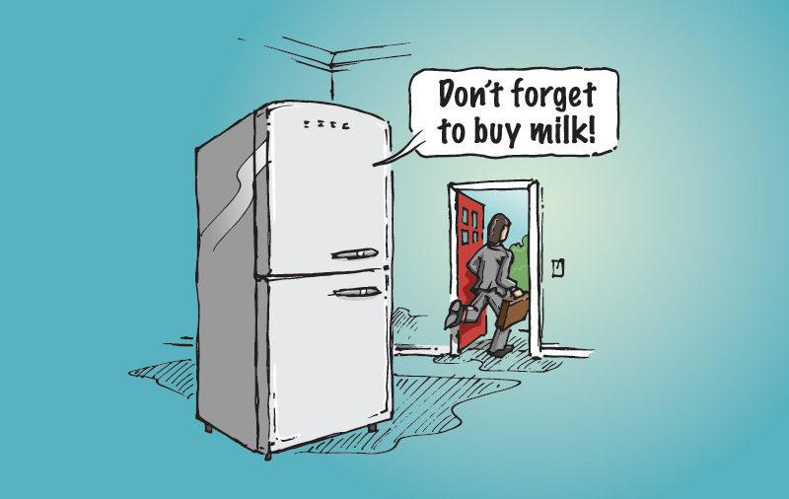
Internet-of-Things?
Prof. Panchanan Nath :: Assistant Professor, Dept. of CSE :: NIST University :: Jan-July 25

Slide 3
How Does My Fridge Do That?
You are leaving the home (sense user)
There’s no milk in fridge (sense object)
Use this information to make a decision (process)
Inform user of decision (communicate)
Prof. Panchanan Nath :: Assistant Professor, Dept. of CSE :: NIST University :: Jan-July 25

Slide 4
How Does My Fridge Do That?
You are leaving the home (sense user)
What type of sensor?
Distinguish between parent and child
Identify reason for leaving home
Identify other contexts (e.g., store hours)
There’s no milk in fridge (sense object)
Use this information to make a decision (process)
Inform user of decision (notify)
Prof. Panchanan Nath :: Assistant Professor, Dept. of CSE :: NIST University :: Jan-July 25

Slide 5
How Does My Fridge Do That?
You are leaving the home (sense user)
There’s no milk in fridge (sense object)
What type of sensor?
Is milk needed?
No milk or “little” milk? (prediction)
Use this information to make a decision (process)
Inform user of decision (notify)
Prof. Panchanan Nath :: Assistant Professor, Dept. of CSE :: NIST University :: Jan-July 25

Slide 6
How Does My Fridge Do That?
You are leaving the home (sense user)
There’s no milk in fridge (sense object)
Use this information to make a decision (process)
Where is processor?
What are the rules?
Fixed rules versus dynamic rules (learning)
Inform user of decision (notify)
Prof. Panchanan Nath :: Assistant Professor, Dept. of CSE :: NIST University :: Jan-July 25

Slide 7
How Does My Fridge Do That?
You are leaving the home (sense user)
There’s no milk in fridge (sense object)
Use this information to make a decision (process)
Inform user of decision (notify)
How?
When?
Privacy?
Subtleness?
Information overflow?
Prof. Panchanan Nath :: Assistant Professor, Dept. of CSE :: NIST University :: Jan-July 25

Slide 8
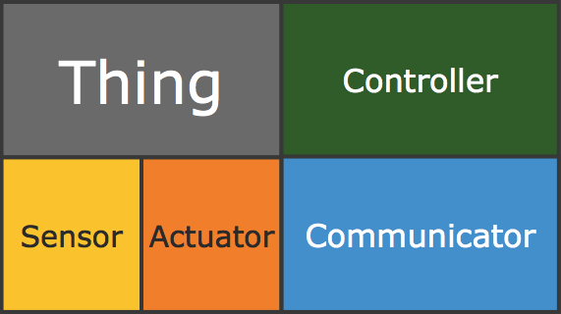
Internet-of-Things (IoT)
Physical object (“thing”)
+
Controller (“brain”)
+
Sensors
+
Actuators
+
Networks (Internet)
Prof. Panchanan Nath :: Assistant Professor, Dept. of CSE :: NIST University :: Jan-July 25

Slide 9
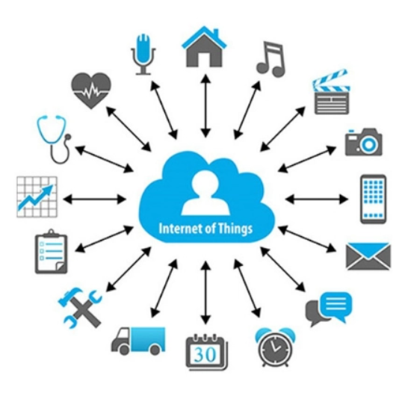
Finally, IoT
IoT is a sensor network of billions of smart devices.
Connect people, systems and applications to collect and share data.
Internet of Things (IoT) is the network of physical objects or "things".
Embedded with electronics, software, sensors, and network connectivity.
Enables these objects to collect and exchange data.
Prof. Panchanan Nath :: Assistant Professor, Dept. of CSE :: NIST University :: Jan-July 25

Slide 10
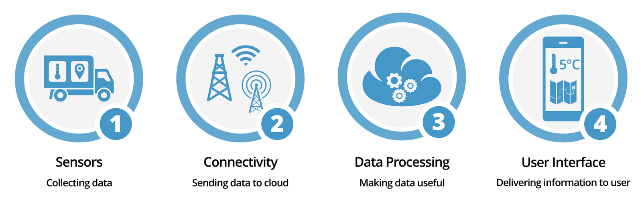
How IoT works?
Sensors/Devices
Connectivity
Data Processing
User Interface
Prof. Panchanan Nath :: Assistant Professor, Dept. of CSE :: NIST University :: Jan-July 25

Slide 11
What are we learning in this course?
Module - I [10 Hrs] Introduction & Concepts: Introduction to Internet of Things, Physical Design of IOT, Logical Design of IOT, IOT Enabling Technologies, IOT Levels. Domain Specific IOTS: Home Automation, Cities, Environment, Energy. Retail, Logistics, Agriculture, Industry, Health & Life Style, Challenges and Issues
Module - ll [10 Hrs] M2M & System Management with NETCONF-YANG: M2M, Difference between IOT and M2M, SDN and NFV for IOT, Software defined Networking. Network Function Virtualization, Need for IOT Systems Management, Simple Network Management Protocol, Limitations of SNMP, Network Operator Requirements, NETCONF, YANG, IOT Systems management with NETCONF-YANG
Module - III [10 Hrs] Protocols-Issues with IoT Protocols: Protocol Standardization for loT and WSN Protocols-SCADA and RFID IoT Standardization Protocols IEEE802.15.4-BACNet Protocol, Architecture - Network layer - APS Layer - Security.
Module - IV [10 Hrs] Case Study and loT Application Development: IoT applications in home-infrastructures security-Industries- IoT electronic equipments. Use of Big Data and Visualization in loT Industry 4.0 concepts - Sensors and sensor Node
Prof. Panchanan Nath :: Assistant Professor, Dept. of CSE :: NIST University :: Jan-July 25

Slide 12
What we can do?
Challenges :: Security, privacy and data sharing
Insufficient testing and updating
Software complexity
Data volumes and interpretation
Integration with AI and automation
Application Development ::
Smart Home
Smart Cars
Activity Trackers
Parking Sensors
Health cares
Smart City
Voice Assistance
Prof. Panchanan Nath :: Assistant Professor, Dept. of CSE :: NIST University :: Jan-July 25

Slide 13
Resources
Books:
VijayMadisetti, ArshdeepBahga," Internet of ThingsA Hands-On- Approach", 2014, ISBN:978 0996025515
Honbo Zhou, "The Internet of Things in the Cloud:A Middleware Perspective-CRC Press-2012
ArshdeepBahga, Vijay Madisetti, "Internet of Things (A Hands-On-Approach)", VPT, 2014.
Slides and other materials:
Check Google Classroom
Tools :
FIT IoT-LAB
Cisco Packet Tracer
Wireshark
Contiki Cooja
NS3
Many more ….
Prof. Panchanan Nath :: Assistant Professor, Dept. of CSE :: NIST University :: Jan-July 25

Slide 14
Q & A
Question ?
Prof. Panchanan Nath :: Assistant Professor, Dept. of CSE :: NIST University :: Jan-July 25

Slide 15
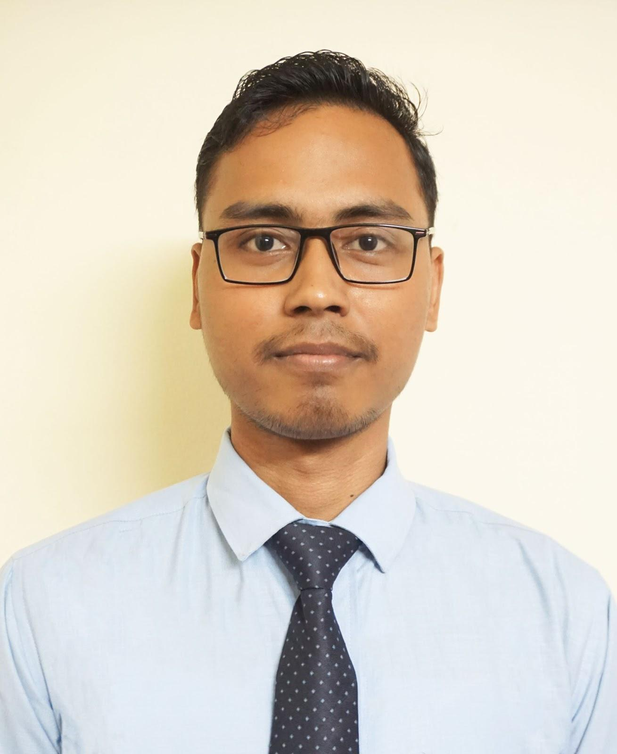
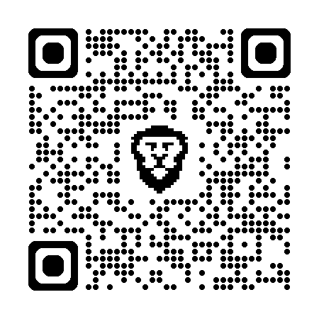



About me
Assistant Professor @ Dept. of CSE, School of CSE, NIST University
Cyber Crime Intervention Officer @ ISAC India
Worked as Cyber Security Research Associate @ R & D Team, EC-Council
Worked as Teaching Assistant @ NIELIT Guwahati
Worked as Cyber Security Consultant @ Assam Gramin Vikash Bank
Worked as Graduate Research Fellow @ EC-Council University, USA.
Worked @ CoE Cyber Security JNTUH Hyderabad.
Founder & CEO @ EncryptoCyberspace
Founding Convenor @ Cyber X Secure Club, CITK
Certified Ethical Hacker, Penetration Tester, Network Security Associate.
Involved more than 8+ years in the Cyber Security domain.
5+ year of Experience in providing training in Cyber Security.
Published 5 articles in SCI Journal, Tire & Core Conference and Book chapters
Major Certifications –
CCSP, CCIO, CEH, CCNA, CC, CSCU, NSE_{3x}, CompTIA CySA +,
CompTIA PenTest+, and a few more.
Er Panchanan Nath
Scan to know more
Prof. Panchanan Nath :: Assistant Professor, Dept. of CSE :: NIST University :: Jan-July 25

